Slide 1
Land adjacent to Fownhope Medical Centre Common Hill Lane Fownhope
Approval of reserved matters following outline approval 171637
(Site for residential development of up to ten dwellings with associated vehicle access).
Update – 1st November 2023
Kevin Braybrook, Chair FPC

Slide 3
The Application – House Types
10 market value homes with access via Common Hill Lane
Plots 1 – 4:
2 x 2 bed semi-detached houses
2 x 3 bed semi-detached houses
Plots 5 and 6 – 3 bed detached houses
Plots 7, 8 and 9 – 4 bed detached houses
Plot 10 – 3 bed chalet bungalow

Slide 4
Current Situation
Outline approval granted in Nov 2020 established the principle of development for 10 full market value homes with access from Common Hill Lane.
Current application for approval of Reserved Matters relates to:
Layout
Scale
Appearance
Landscaping
FNP has regained full weight, so we should consider the above in relation to policies within the FNP

Slide 5
FPC Objection
Site allocated in FNP for “homes contributing primarily to local need”
FPC accept District Valuers conclusion that site could not support discounted affordable housing
However, FPC wish to see more smaller 2/3 bed semi-detached homes

Slide 6
Planning Officer response
Meeting with Heather Carlisle Friday 27th October
Sales price of homes not considered to be a material planning matter.
Scale refers to The height, width and length of each building proposed in relation to its surroundings.
40% of the planned homes are 2 or 3 bed semi-detached properties,

Slide 7
What Next?
Planning Officer awaiting response from Freemans to Objections raised
FPC will have sight of response/revised drawings with option to comment
Planning Officer will decide whether to Approve or Reject Application
Ward Councillor will be informed of decision and can request Committee Referral if decision is to Approve

Slide 8
Committee Referral ?
FNP has regained full weight
Homes contributing primarily to local need
District Valuers Report
Outline Approval granted in November 2020
Based upon DV report dated October 2018, valid for 3 months
Levelling-up and Regeneration Bill

Slide 9
Levelling Up Bill
The Levelling-up and Regeneration Bill became law on 26 October 2023
Put local people at the heart of development – making it easier to put local plans in place and requiring design codes that set out where homes will be built and how they will look.
These plans will deliver more homes in a way that works for communities.
The Levelling-up and Regeneration Act ….. will ensure new development …. is shaped by local people’s democratic wishes.
Communities taking back control of their future with new powers to shape their local area.

Slide 10
Green Lane Footpath
Pedestrian access to village via PROW on Green Lane
FPC own Green Lane
PROW status allows developer to use the footpath as pedestrian access
HC Highways require hard surface to ensure disabled use during all weathers
HC standard Tarmac
Rubber/Grass matting – Not DDA (Disability Discrimination Act) compliant
HC do not have to obtain land owners permission to surface PROW

Slide 11
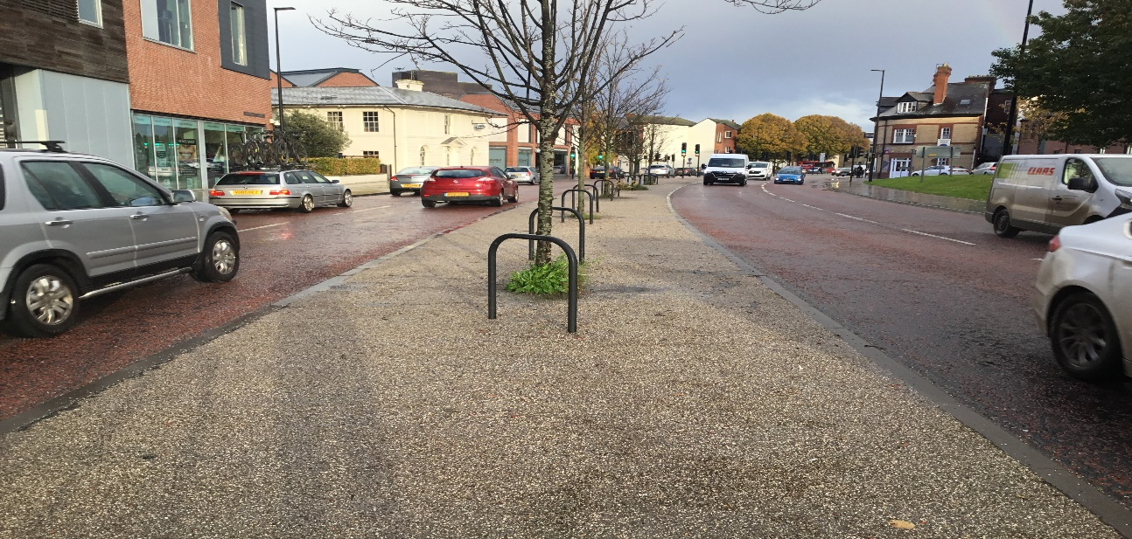
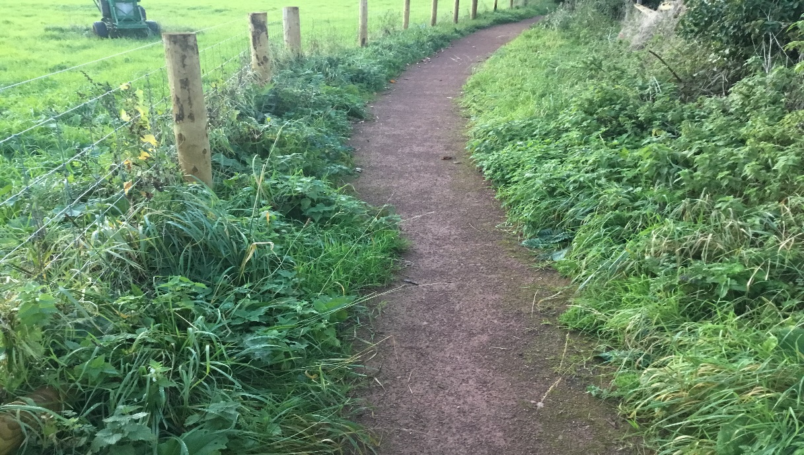
Green Lane Footpath – other surface options
Hoggin
HC would not adopt and maintain.
? FPC accept maintenance responsibility
High Friction Grit Finish
Expensive
Adopted and maintained by HC

