Slide 1
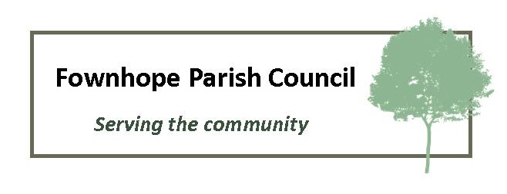
Why might we want to review our Neighbourhood Development Plan?
Herefordshire Council are preparing a new Local Plan which will replace the 2011 Core Strategy
Existing policies within the Core Strategy will change
Neighbourhood Plans need to comply with relevant policies in the new Local Plan
As the draft Local Plan develops, existing NDP’s will start to lose weight
By conducting a review of our Neighbourhood Development Plan and modifying policies to bring them in line with the new Local Plan, we can maintain the weight of our plan.

Slide 2
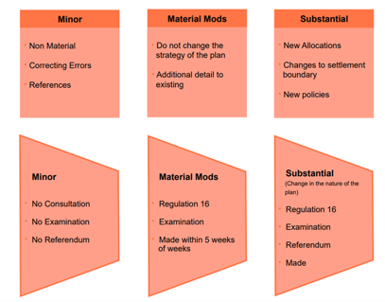
Review Levels

Slide 3
Time Frame
25th March – Consultation on draft Local Plan begins
Spring 2024 – Herefordshire Council will determine land supply for 24/25
2025 – New Local Plan put to examiners
2026 – New Local Plan adopted

Slide 4
What do we know about the new Local Plan?
Rural Settlements will be allocated to one of 4 categories, based upon flood risk, availability of key services, the presence of a Conservation Area and location within the National Landscape:
1.Rural Hubs
2.Rural Hubs with environmental constraints
3.Service Settlements
4. Service Settlements with environmental constraints
Fownhope has been put into category 4 - Service Settlements with environmental constraints

Slide 5
How might the new Local Plan impact Fownhope?
Our allocation to category 4 - Service Settlements with environmental constraints, gives us some protection from major development.
However, Fownhope will be expected to build 20 new homes over the plan period to 2041.
These 20 new homes will be in addition to the new homes currently being built on 3 of the 4 allocated sites in our existing Neighbourhood Plan

Slide 6
Where might another 20 new homes be built?
Our existing Neighbourhood Plan includes a fourth site that has not yet been bought forward for planning approval
If this site is developed, it could account for 10 (or possibly more) of the 20 new homes required
The balance might then be built on:
in-fill sites
Or a new development site

Slide 7
What are In-Fill Sites
In-Fill sites are small pieces of land within the existing Settlement Boundary that might be suitable for 1 or 2 homes
Our existing Neighbourhood Plan allows for development on In-Fill sites, subject to planning approval

Slide 8
What about a new Development Site?
Our existing Neighbourhood Plan does not allow for major development on sites other than the 4 allocated sites
In order to add a new development site, we would need to conduct a Substantial review of our existing plan
This would involve considering potential sites brought forward by landowners and a parish wide referendum to select a site(s) acceptable to the majority of parishioners

Slide 9
What if we don’t review our existing Plan?
If we do not conduct a review of our existing plan, it will gradually lose weight as the new Local Plan evolves
When the new Local Plan is adopted, which is expected to be sometime in 2026, the new Local Plan would take precedence over our Neighbourhood Plan
This would mean that Herefordshire Council could consider any applications for development within the parish without referring to the wishes of parishioners as expressed in our Neighbourhood Plan

Slide 10
Our Existing Neighbourhood Development Plan
Adopted March 2016
Set out a vision for Fownhope to 2031
Allocated 4 development sites:
Mill Field (Cherry Hill)
Old Potato Barn (Cherry Hill)
Rear of Lower House Gardens
Adjacent to Medical Centre

Slide 11
The existing Fownhope Neighbourhood Development Plan includes policies intended to:
Protect open spaces not allocated for development
Provide affordable housing to contribute to local need
Set design standards
Promote sustainable development
Conserve Fownhope’s historic character
Protect wildlife and our position in the Wye Valley National Landscape
Support local businesses

Slide 12
What has our Neighbourhood Development Plan achieved?
Protecting open spaces – major development has been restricted to allocated sites
Providing affordable housing – 5 affordable homes have been delivered, but we had expected more.
Setting design standards, promoting sustainable development, conserving Fownhope’s historic character and supporting local business - all representations brought to Fownhope Parish Council are considered against the policies contained within the Neighbourhood Development Plan and decisions taken accordingly
Protecting wildlife and our position in the Wye Valley National Landscape – we have upheld our Dark Skies policy and supported initiatives championed by Natural England and Hereford Wildlife Trust.

Slide 13
Allocated Development Sites
Mill Field | Allocated - 12 dwellings Delivered – 10 market, 5 affordable homes
Potato Barn | Allocated – 10 dwellings Delivered – 10 market homes
Medical Centre | Allocated – 7 dwellings Delivered – 10 market homes
Lowerhouse Gardens | Still to be brought forward
Herefordshire Council were unable to demonstrate a 5 year housing land supply between 2015 and 2021. This reduced the weight of all Neighbourhood Plans, meaning that NDP policies did not have to be applied to applications considered during this period.

Slide 14
How has the Neighbourhood Development Plan performed since it was adopted?
Major development (>10 homes) has been restricted to allocated sites
Developments have included sustainable features
But:
The reduced weight of all NDP’s when applications for allocated sites were submitted, meant that less affordable housing has been delivered than expected.

Slide 15
Reviewing our Neighbourhood Development Plan would allow us to:
Bring our policies into line with the new Local Plan, thus ensuring that our Neighbourhood Development Plan retains weight (while Herefordshire Council is able to demonstrate a 5 year land supply)
And might also enable us to:
Address any ambiguous details within existing policies, thus enabling us to better enforce those policies

Slide 16
Fownhope Parish Council believe a review of our Neighbourhood Development Plan would be beneficial because:
It would give us some control over new development and enable us to determine where any new development takes place.
It would enable us to influence the size, scale and design of both small scale and any major new development
It could help us to promote initiatives aimed at improving road safety, managing our environment and reducing carbon emissions
We need your input to help us decide whether to review the NDP.
Please complete our questionnaire and make comments on the form, by contacting the clerk or speaking to any councillor.

