Slide 1
Recycling and Waste Management - Future Service

Slide 2
Why are we changing?
Council Climate Emergency
Supported by - HCC Integrated Waste Strategy Targets
Contracts
Collection contract ends Nov 2023
Legislation
Environmental Act

Slide 3
Consultation - Task & Finish Group Sep 2019 -2020
Task & Finish Group Sep 2019 -2020 – Key Recommendations
Vison
“Waste not, want not… we value resources and their use. We will reduce resource consumption and embrace the circular economy to maximise the life of products and materials. We treat the materials we collect as resources not waste. We will achieve this by prioritising the waste hierarchy, maximising waste prevention and reuse.”

Slide 4
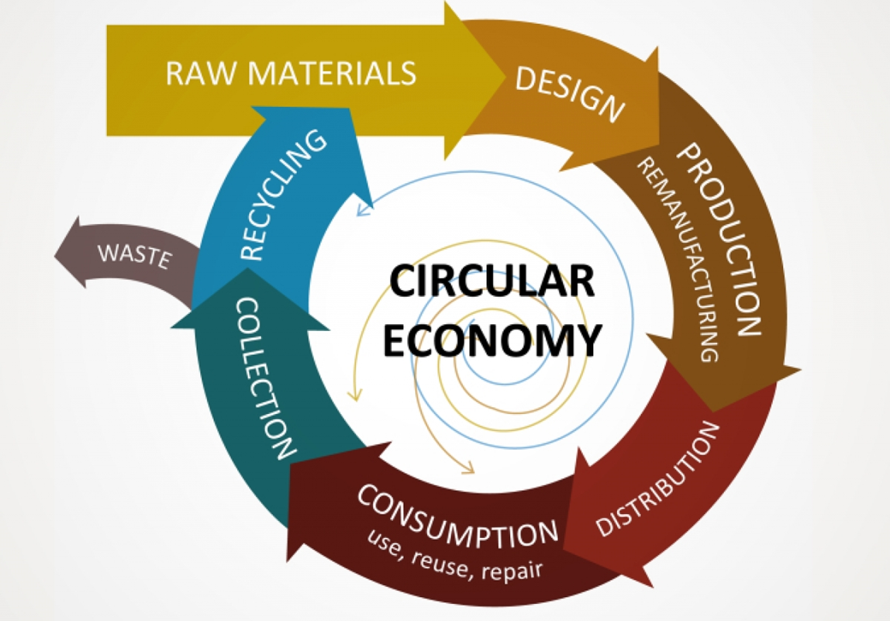
Circular economy model

Slide 5
Public Consultation – Dec 2020 – Feb 2021
Public Consultation – Dec 2020 – Feb 2021
3,498 residents and 181 businesses responded (42% urban & 58% rural)
Twin stream favoured
86% of residents thought more needed to be done to reduce rubbish and increase recycling

Slide 6
HCC Strategy Waste Targets
Carbon zero Herefordshire 2030
1 % to landfill by 2025 (currently 20%)
Residual household Waste - Lower than 330kg per household per year by 2035
National Reuse & Recycling
  55% by 2025 - 60% by 2030 - 65% by 2035

Slide 7
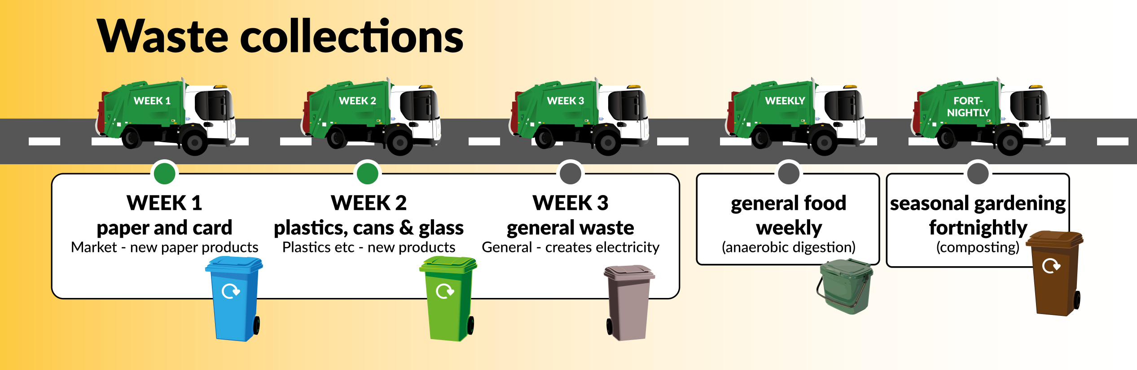
Future Service - Twin Stream Recycling

Slide 8
Notes:
2019 – Two season waste analysis project – What were asking is reasonable
40% of people inform us during the consolation that they put things in there recycling bin that shouldn't be there

Slide 9
Waste service specification and design
Service spec & design – Ongoing.
Detail regarding collections etc
Procurement August – Sep 2022 to award – Jan 2023
Notes:
Below will be looked at during the service design spec.
Nappies
Medical needs
Large families
Isolated residents
Properties with limited storage space
Frequency

Slide 10
Flats & communal developments
Full review of all flats across Herefordshire underway
Collection Trial – Twin stream recycling across 15 flat blocks in Hereford City and each Market Town - Different lid types
Flats above shops survey – Hereford City & Market Towns
Managing agent and housing association collaboration
Notes:
Flats above shops consolation
To add photos of flat bin types for trial & bags/boxes for flats/ terraced
Flats above shops survey
Managing agent and housing association collaboration
Full review of flats
Bespoke communications plan

Slide 11
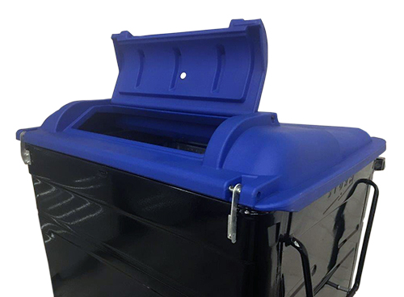
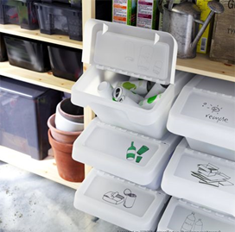
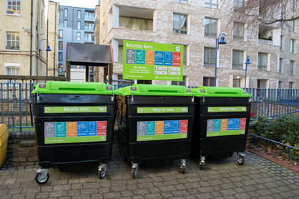
Flats & communal developments

Slide 12



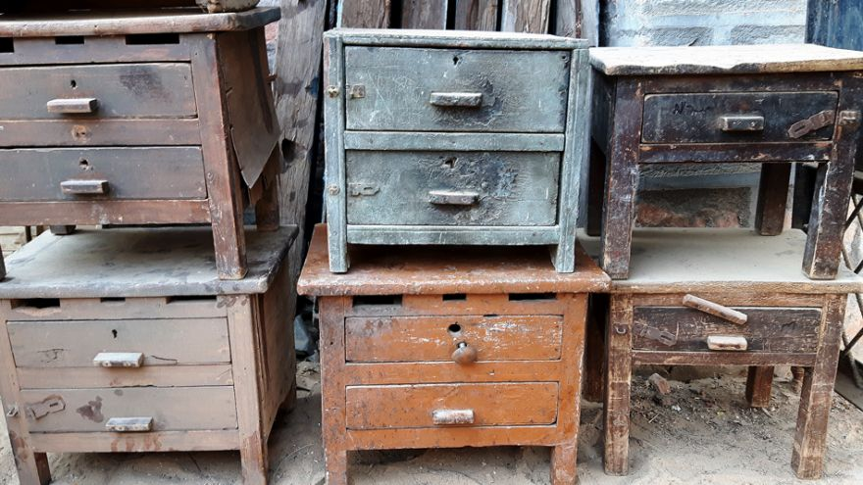

Waste reduction & reuse pilots

Slide 13
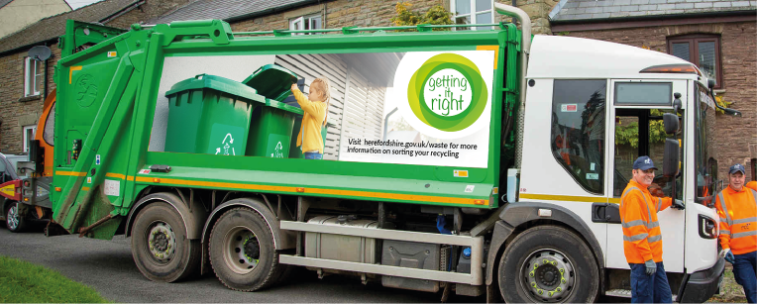

Communications
12 Month Campaign with 4 focuses aimed at reducing recycling contamination now.
Second phase to encourage adoption of new service
Notes:
Focus 1: Plastic film, packets and pouches (May-July 2022)
Focus 2: Food (August – October 2022)
Focus 3: small WEEE batteries (November – January 2022)
Focus 4: Nappies – correct disposal of - (February -March 2023)

Slide 14
Break out discussion
To achieve our ambitious recycling targets and support in a more sustainable county we will need to work with our local communities to encourage people to reduce, re-use and recycle more. Behaviour change is hugely important, and people are more likely to reduce/reuse/recycle if they can see others are doing it as well.
What opportunities is there within your local parishes to support; and how can we work across the council and parish areas to achieve this?

